Slide 1
Heart Attack Analysis
CSC 761 – U15 Advanced Artificial Intelligence
Team Members :
Lalitha Priya Bijja – 101168225
Venkata Surya Deepak Lakshimpalli - 101143451

Slide 2
Objective
Main goal is to predict the risk of heart disease.
We analyzed the dataset and built predictive models using Random Forest and Convolutional Neural Network (CNN) algorithms, and evaluate performance.

Slide 3
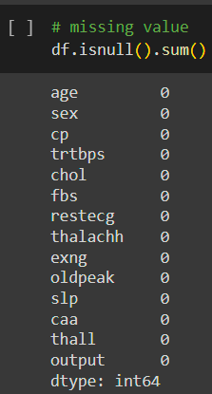
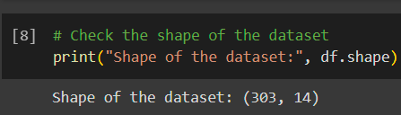
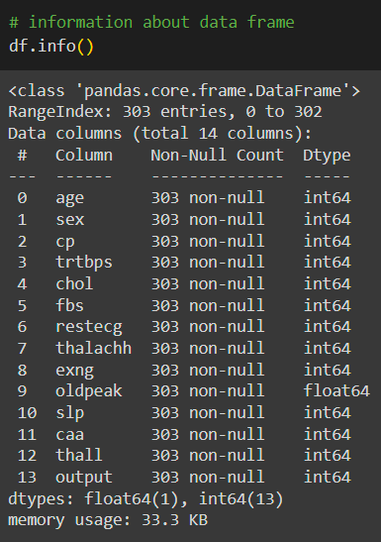
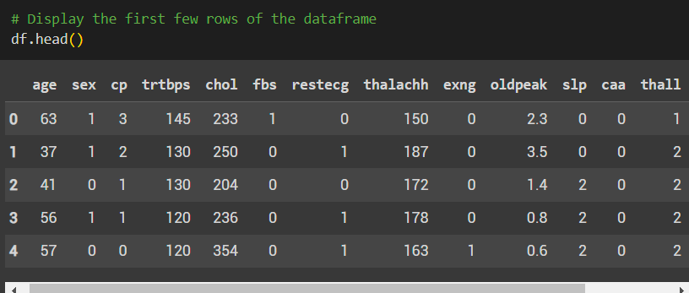
Data Exploration and Preprocessing
Dataset contained 303 entries and 14columns.
The were no missing values
Performed EDA to reveal insights into the distribution of categorical variables and their relationship with the target variable.
Performed feature engineering and preprocessing steps such as one-hot encoding categorical variables & standardizing numerical features.
Dataset source: Kaggle.com

Slide 4
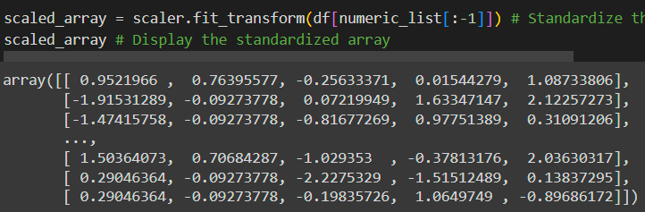
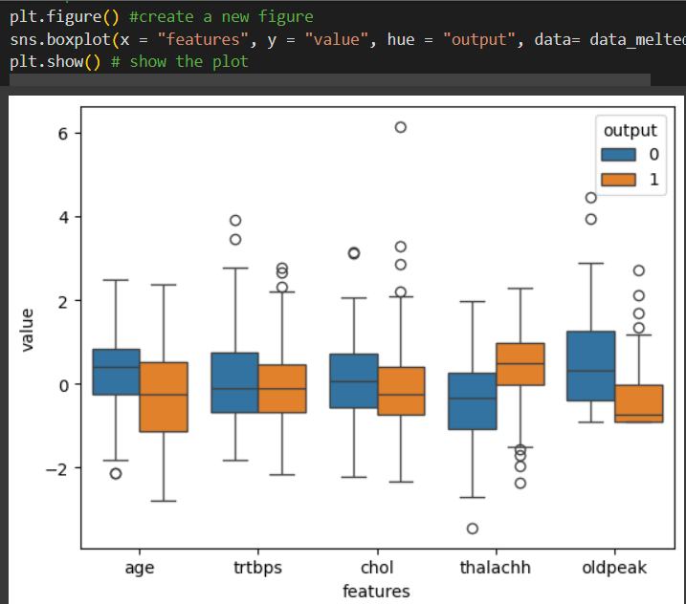
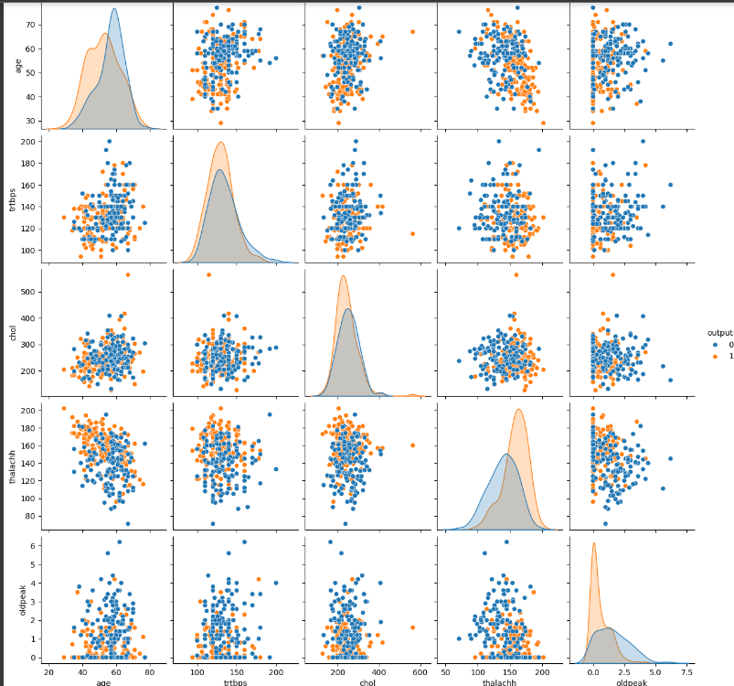
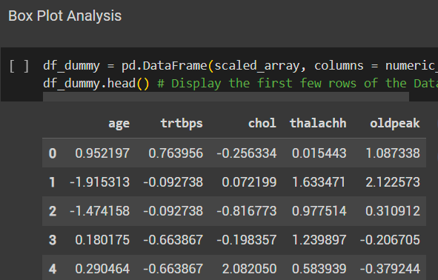
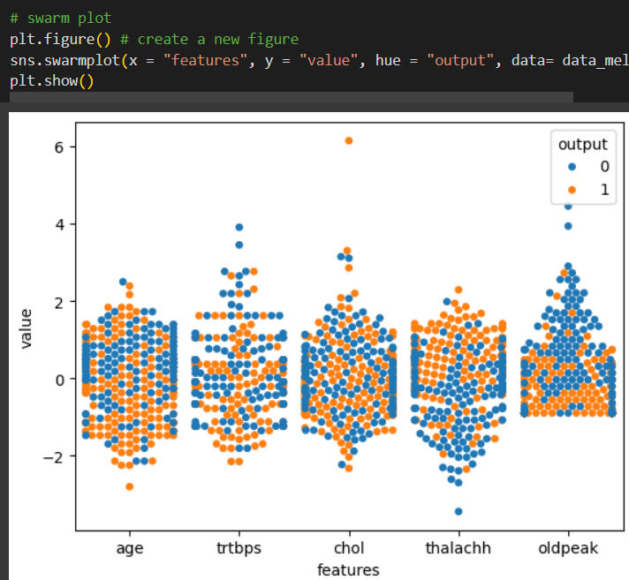
Standardizing Numerical Features
Box Plot
Box plot Analysis
Numeric Feature analysis
Swarm plot

Slide 5
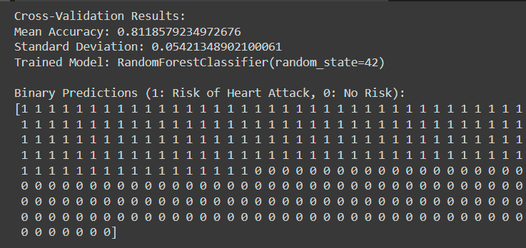
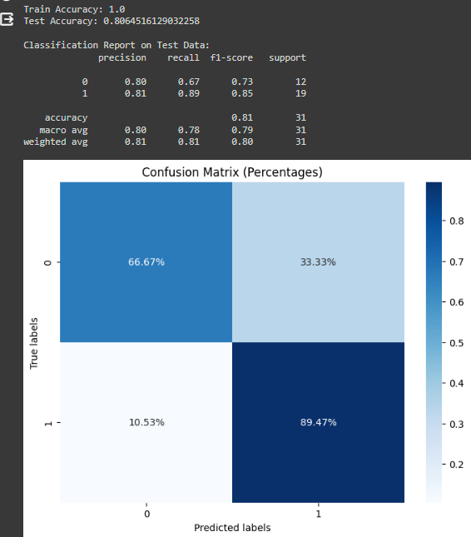
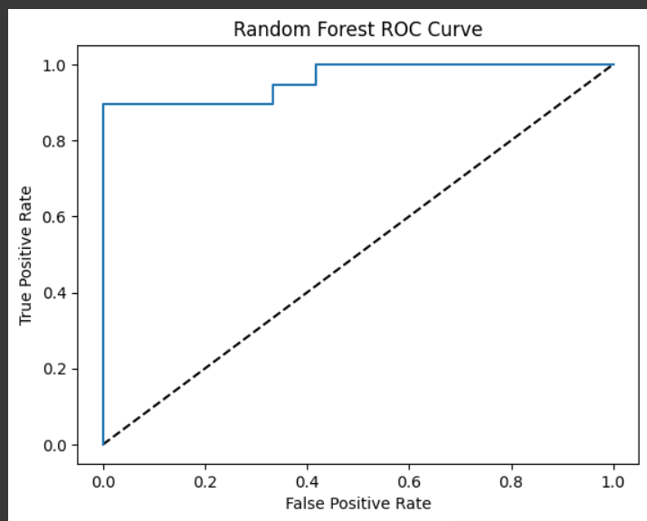
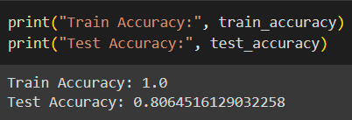
Model Building
Random Forest Model
Dataset was split into training and testing sets with a 90-10 ratio.
A Random Forest Classifier with 100 estimators was trained on the training set.
The model achieved a training accuracy of 100% & testing accuracy of 81% approx.
Evaluation metrics such as precision, recall, F1-score, Confusion matrix were computed.
Cross-validation was performed to assess model’s generalization performance; got mean accuracy pf 82% approx.

Slide 6
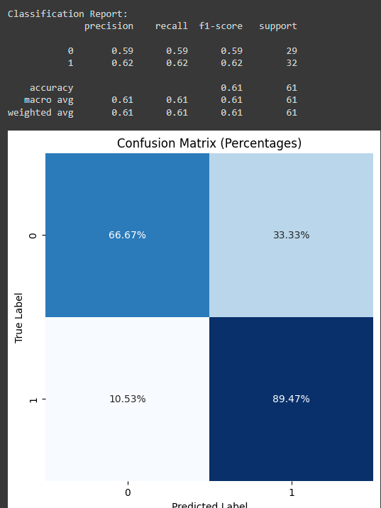
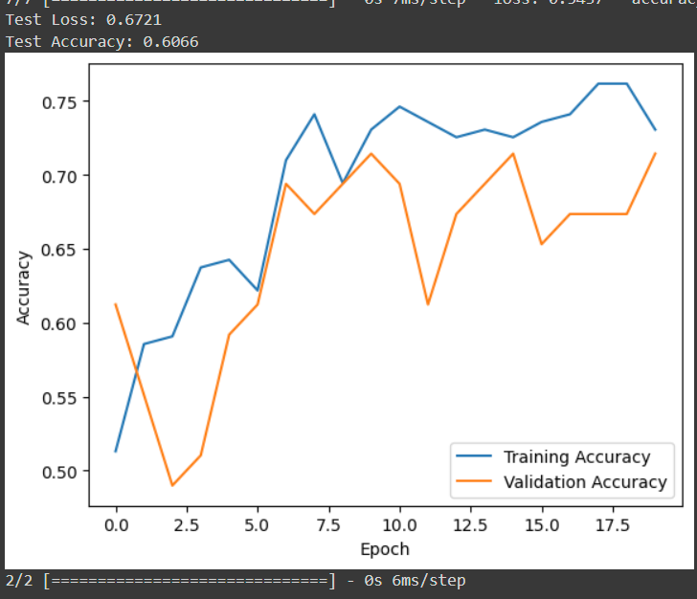
Convolutional Neural Network Model
Dataset was split into training and testing sets with 80-20 ratio.
CNN model having convolutional and dense layers is defined and trained using TensorFlow and Keras.
Achieved Testing accuracy of 61% approx.
Evaluated the model’s predictive performance by generating classification report and confusion matrix.

Slide 7
Conclusion
Both Random Forest and CNN models were trained and evaluated for predicting heart disease risk.
Random Forest model demonstrated better accuracy compared to CNN model.

Slide 8
Future work
Exploring more feature engineering techniques to enhance model performance.
Experiment with different ML & DL algorithms to identify the best performing model.
Incorporate more advanced techniques such as hyperparameter tuning and ensemble learning to enhance model performance.

